Slide 1
Integration

Slide 2
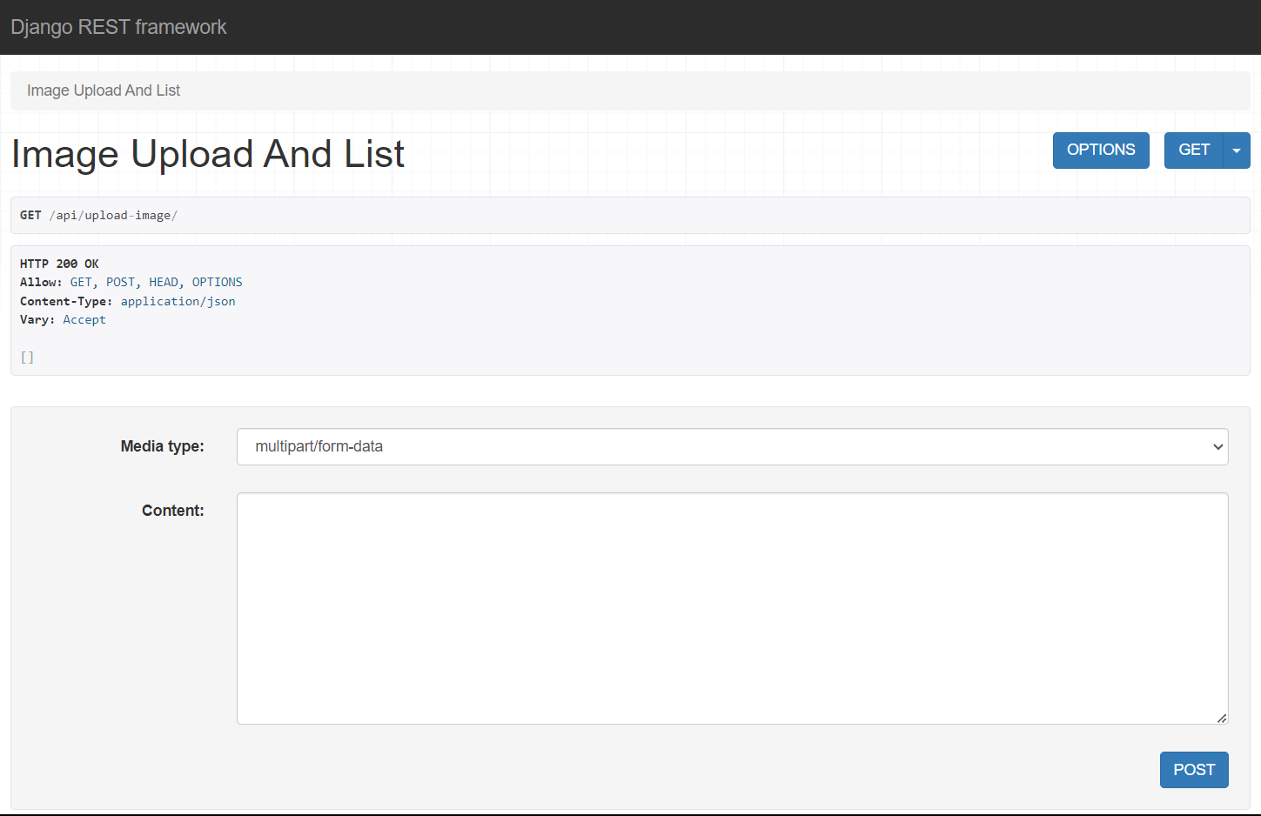
Upload Images View
Utilizes pillow library. Implemented pytesseract for OCR purpose. Image upload is being tested using Postman application. Blocker “content-disposition”.

Slide 3

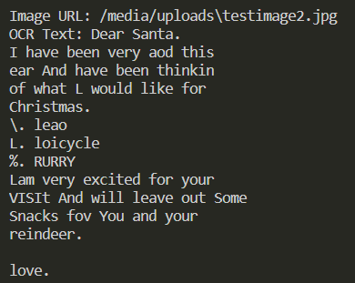
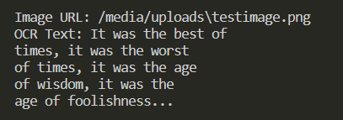
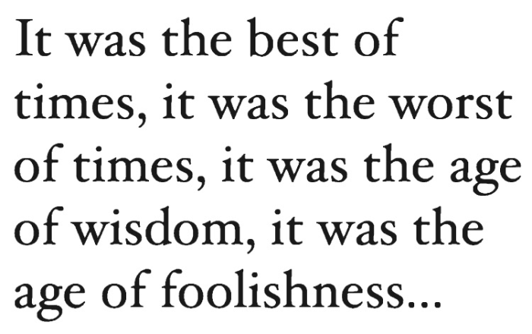
Unstructured data reading in MongoDB
Text read
Image - jpg
Text read
Image - png

Slide 4
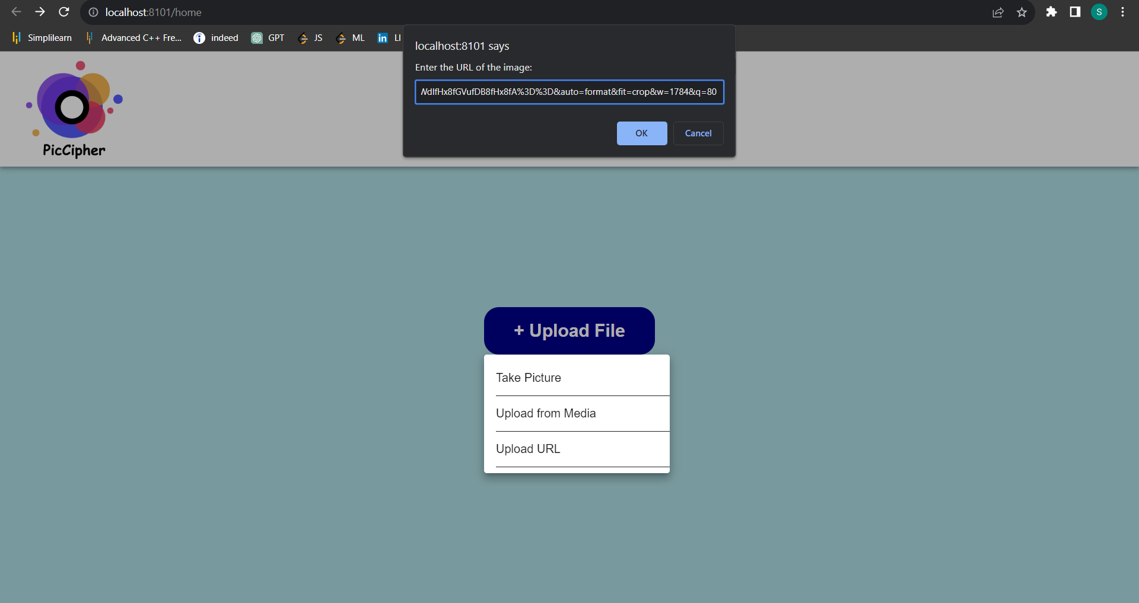
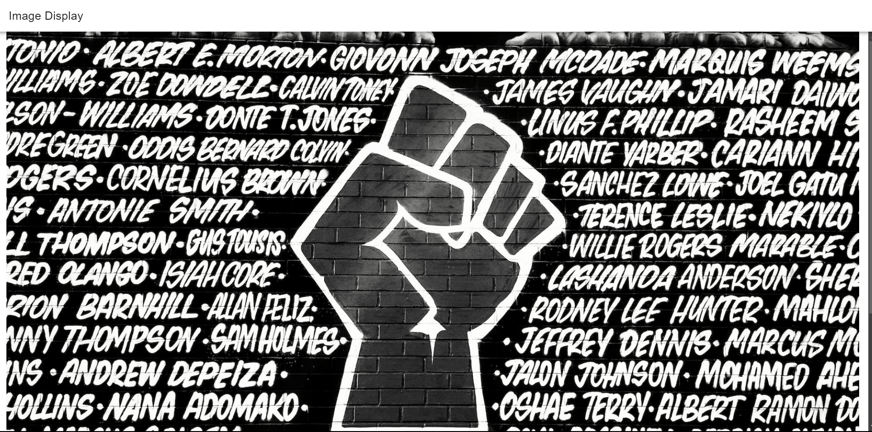
Image uploading using URL

